Slide 1
Project 4
Members: Ross Boersma, James Pelletier, Laura Magallanes, Rob Huibregtse, Jane Hedges
Notes:
Ross

Slide 2
Project Overview and Scope
Use SQL to retrieve the data.
Clean and Normalize Data.
Removed Outliers / Inaccurate Values.
Add additional data from trusted sources to improve model accuracy.
Train a model to predict life expectancy in multiple countries.
Model type: Linear regression
Model: XGBoost
Supports categorical variables - important for dealing with the country status of Developing vs. Developed.
Handles null values well - important when dealing with spotty data.
Notes:
Ross

Slide 3
Research Questions: Predicting Life Expectancy
Which variables have the most significant impact on life expectancy?
Which variable has the most impact?
Which variable has the least impact?
Which countries have the highest / lowest life expectancy?
What specific policy recommendations can be made to countries that are looking to improve their life expectancy?
Would our ML model be less accurate for COVID-19 pandemic years?
Notes:
Ross

Slide 4
Data Set: WHO Life Expectancy
Time frame: 2000 - 2015
Health metrics:
Life expectancy (Target variable)
Adult Mortality
Infant deaths
Under-five deaths
BMI
Thinness 1-19 years
Thinness 5-9 years
Alcohol
Hepatitis B
Measles
Polio
Diphtheria
HIV/AIDS
Economic metrics:
Total expenditure
Percentage expenditure
Status (Developing vs. Developed)
GDP Per Capita
Population
Income composition of resources (Calculated index for the composition of income sources for a country’s population - a good proxy for how the average person is doing financially)
Schooling (# of years the average citizen spends in school)
Notes:
Laura

Slide 5
Top 5 Developed vs Developing Countries Life Expectancy
Developed | Avg Life Expectancy
France | 82.7
Italy | 82.3
Canada | 82.23
Spain | 82.2
Australia | 82
Developing | Avg Life Expectancy
Chile | 79.5
Costa Rica | 78.7
Greece | 78.6
Panama | 77.3
Argentina | 75.8
Notes:
James

Slide 6
Top 5 Developed vs Developing Countries Health Indicators
Developed | Avg HIV & AIDS | Avg BMI | Avg Under Five Deaths
Belgium | 0.1 | 59.15 | 1
Spain | 0.1 | 58.13 | 1.93
Romania | 0.1 | 55.28 | 3.33
Italy | 0.1 | 54.45 | 2.33
Australia | 0.1 | 54.38 | 1.30
Developing | Avg HIV & AIDS | Avg BMI | Avg Under Five Deaths
Lebanon | 0.1 | 63.44 | 1
Chile | 0.1 | 60.55 | 2
Turkey | 0.1 | 59.30 | 33.5
Greece | 0.1 | 58 | 1
Ukraine | 0.64 | 56.85 | 6.16
Notes:
James

Slide 7
Top 5 Developed vs Developing Countries Economic Indicators
Developed | Avg GDP | Avg Population | Avg Schooling
Netherlands | 39640.34 | 5069357 | 17.87
Australia | 35335.27 | 3812053 | 19.96
Belgium | 29355.64 | 774897 | 18.5
Italy | 25037.38 | 36178703 | 15.90
Germany | 23179.17 | 37872128 | 16.59
Developing | Avg GDP | Avg Population | Avg Schooling
Argentina | 9475.92 | 26127794 | 16.98
Russian Federation | 6687.23 | 57724795 | 13.77
Gabon | 5791.21 | 1231027 | 12.48
Brazil | 5568.66 | 89944900 | 14.25
Mexico | 5424.67 | 6430402 | 12.13
Notes:
James

Slide 8
Model Performance and Accuracy
R-squared value: 0.946
Mean squared error: 5.019
Mean absolute percentage error: 0.022
We are pretty satisfied with the predictive capability of our model - there are likely a lot more things that factor into life expectancy in reality than what’s captured in the data, so this degree of accuracy is a win!
Notes:
Rob

Slide 9
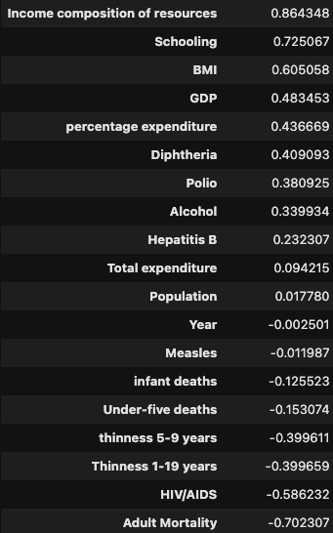
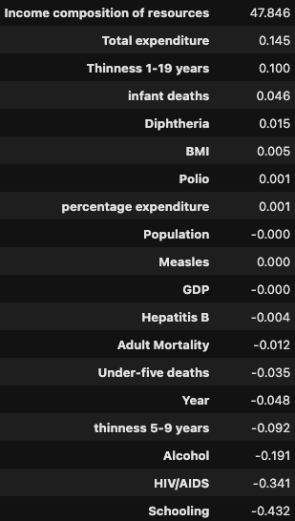
Variables
Correlation coefficient with Life Expectancy
Regression coefficient with Life Expectancy
Notes:
Jane

Slide 10
Key Findings
Income Composition of Resources (ICOR) is the most significant factor for life expectancy.
Index for breakdown of income sources of the average person - a proxy for total economic development.
HIV/AIDS strongly reduce life expectancy.
KEY AREA FOR INTERVENTION
Education had a larger impact than anticipated.
More years spent in school led to longer life expectancy.
Population had the lowest impact on life expectancy.
The impact of population may be indirect and harder to see.
Of the diseases tracked in the data, Measles had the lowest impact
This makes sense; Measles has a widely available vaccine.
Notes:
Jane

Slide 11
Policy Recommendations
Promote and protect local industries.
Investing in industries where the country has a competitive advantage promotes job market and ensures stability in wages.
Establish a high minimum wage; ICOR (Incremental Capital Output Ratio) is effectively a measure of how well the working class is doing.
Implement and enforce labor protection laws such as Child Labor Laws, Pay Discriminations Laws, and workplace safety regulations. Additionally, support the establishment of unions to protect rights and ensure compliance.
Invest in higher education.
Countries with higher life expectancies tend to put the average person through around 20 years of school.
Ensure affordability of education; student debt detracts from ICOR.
Develop or expand hybrid and remote educational programs for students who live in remote areas.
Prevent and treat disease.
Countries facing a relatively high rate of HIV/AIDS must enact policies and provide education to treat and prevent the spread of this and other diseases.
Countries facing a relatively high rate of HIV/AIDS must expand their treatments programs to integrate affordable treatment and mental health services.
Establish a national database to track infected cases, hotspot areas, treatment results, to support data driven policies.
Notes:
Rob

